Slide 1
Spotify most streamed songs Lyn Detwiler and Garrett ward

Slide 2
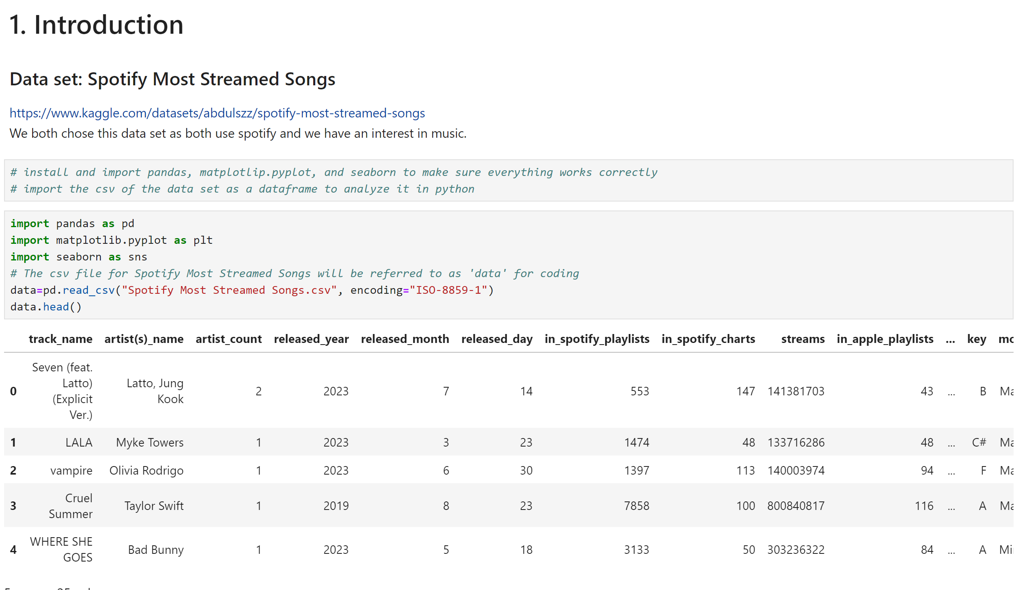
Introduction
Setting up the Jupyter Notebook
We chose the dataset because we both use Spotify and who doesn’t listen to music?
There are 25 variables for the data and 953 entries
To start we import pandas, matplotlib.pyplot, and seaborn
For simplicity as we convert the data into a data frame, it is called by ‘data’

Slide 3
Data set variables & what they mean
Basic Track Info
Steaming Metrics
track_name: Name of the song.
artist(s)_name: Name of the artist(s) performing the song.
artist_count: Number of artists contributing to the song.
released_year, released_month, released_day: Release date details.
in_spotify_playlists: Number of Spotify playlists the song is featured in.
in_spotify_charts: Rank of the song on Spotify charts.
streams: Total number of streams on Spotify.
in_apple_playlists, in_apple_charts: Presence in Apple Music playlists and charts.
in_deezer_playlists, in_deezer_charts: Presence in Deezer playlists and charts.
in_shazam_charts: Rank on Shazam charts.

Slide 4
Data set variables & what they mean cont.
Musical Attributes
bpm: Beats per minute, representing the tempo of the song.
key: Key of the song.
mode: Indicates whether the song is in a major or minor mode.
danceability_%: Suitability of the song for dancing.
valence_%: Positivity of the song’s musical content.
energy_%: Perceived energy level of the song.
acousticness_%: Acoustic sound presence in the song.
instrumentalness_%: Proportion of instrumental content in the track.
liveness_%: Presence of live performance elements.
speechiness_%: Amount of spoken words in the song.

Slide 5
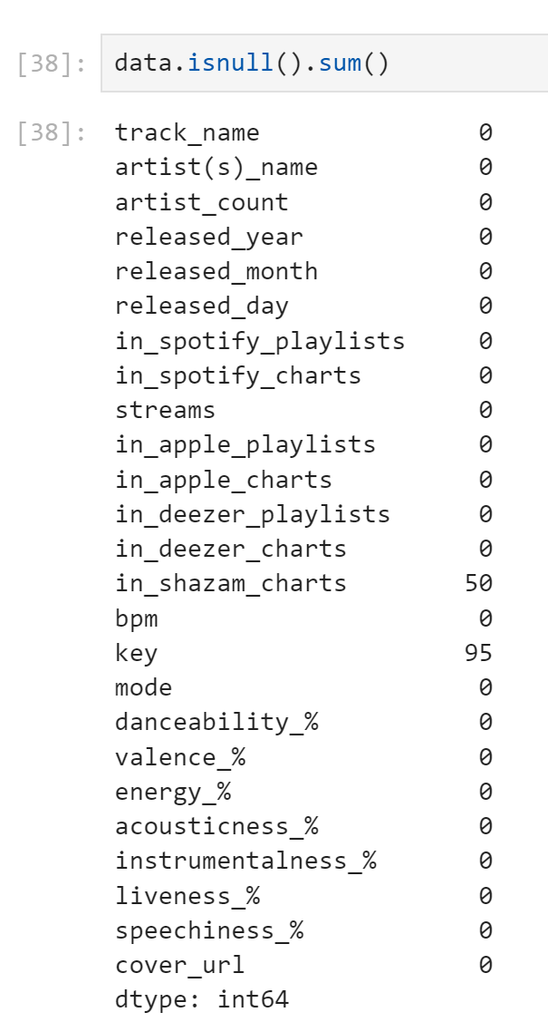
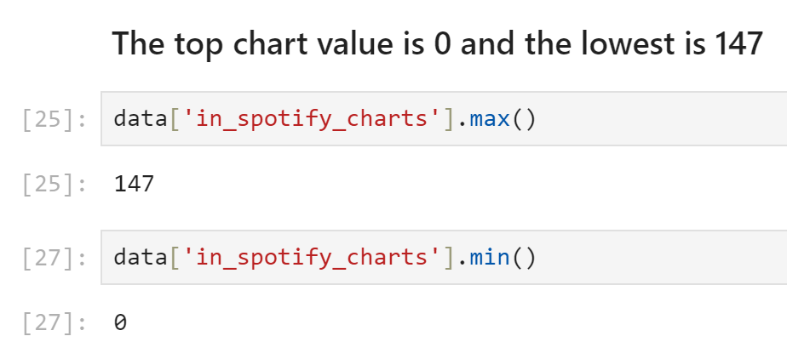
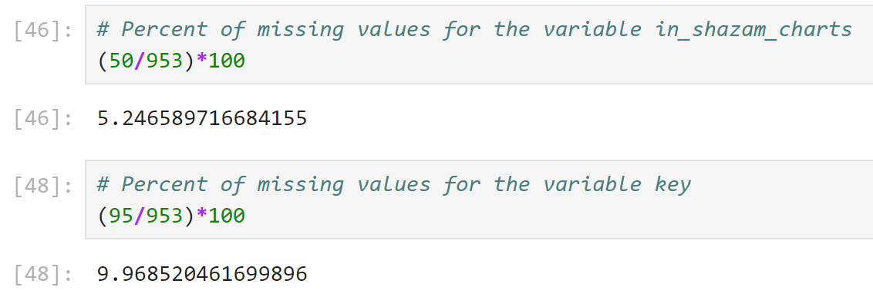
Description of the data
The data types of variables are object and int64
The range of years of songs in the chart is 1930-2023
The lowest chart value is 147 while the highest is 0
in_shazam_charts and key have missing values

Slide 6
Summary Statistics for the data
Variable Name | Count | Mean | Standard Deviation | Min | 25th | 50th | 75th | Max
Artist_count | 953 | 1.56 | 0.89 | 1 | 1 | 1 | 2 | 8
Released_year | 953 | 2018.24 | 11.12 | 1930 | 2020 | 2022 | 2022 | 2023
Released_month | 953 | 6.03 | 3.57 | 1 | 3 | 6 | 9 | 12
Released_day | 953 | 13.93 | 9.20 | 1 | 6 | 13 | 22 | 31
In_spotify_playlists | 953 | 5200.12 | 7897.61 | 31 | 875 | 2224 | 5542 | 52898
In_spotify_charts | 953 | 12.00 | 19.58 | 0 | 0 | 3 | 16 | 147
In_apple_playlists | 953 | 67.81 | 86.44 | 0 | 13 | 34 | 88 | 672
In_apple_charts | 953 | 51.91 | 50.63 | 0 | 7 | 38 | 87 | 275
In_deezer_charts | 953 | 2.67 | 6.04 | 0 | 0 | 0 | 2 | 58
Bpm | 953 | 122.54 | 28.06 | 65 | 100 | 121 | 140 | 206
Danceability_% | 953 | 66.97 | 14.63 | 23 | 57 | 69 | 78 | 96
Valence_% | 953 | 51.43 | 23.48 | 4 | 32 | 51 | 70 | 97
Energy_% | 953 | 64.28 | 16.55 | 9 | 53 | 66 | 77 | 97
Acousticness_% | 953 | 27.06 | 25.996 | 0 | 6 | 18 | 43 | 97
Instrumentalness_% | 953 | 1.58 | 8.41 | 0 | 0 | 0 | 0 | 91
Liveness_% | 953 | 18.21 | 13.71 | 3 | 10 | 12 | 24 | 97
Speechiness_% | 953 | 10.31 | 9.91 | 2 | 4 | 6 | 11 | 64
For every numerical variable we have the count, mean, deviation, min, percentiles, and the max

Slide 7
Proportions for artist count
Category (artist_count) | Frequency | Proportion (%)
1 | 587 | 61.59
2 | 254 | 26.65
3 | 85 | 8.92
4 | 15 | 1.57
5 | 5 | 0.52
6 | 3 | 0.31
7 | 2 | 0.21
8 | 2 | 0.21
Here is a sample of the frequency tables
Using artist count as an example as other variables like in_spotify_playlists have drastically different values

Slide 8
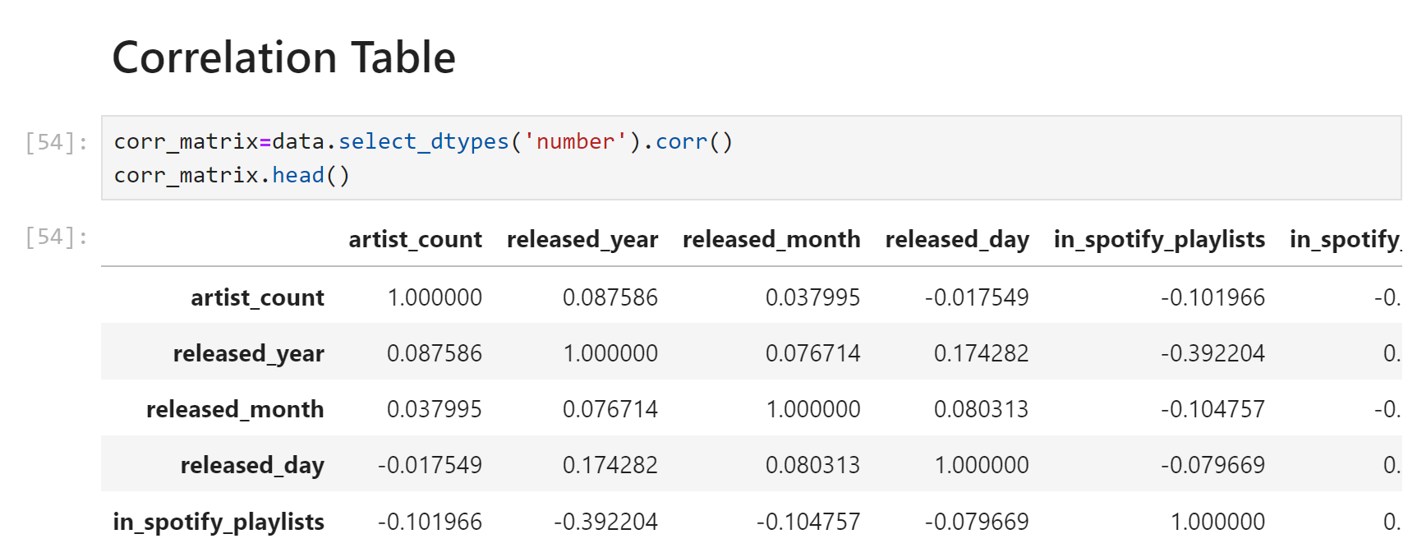
Correlation Table
We created a correlation table using the function we’ve done in class previously
Used the .head() function to just show the first 5 entries of the table
Though it still goes through all numerical variables in the columns

Slide 9
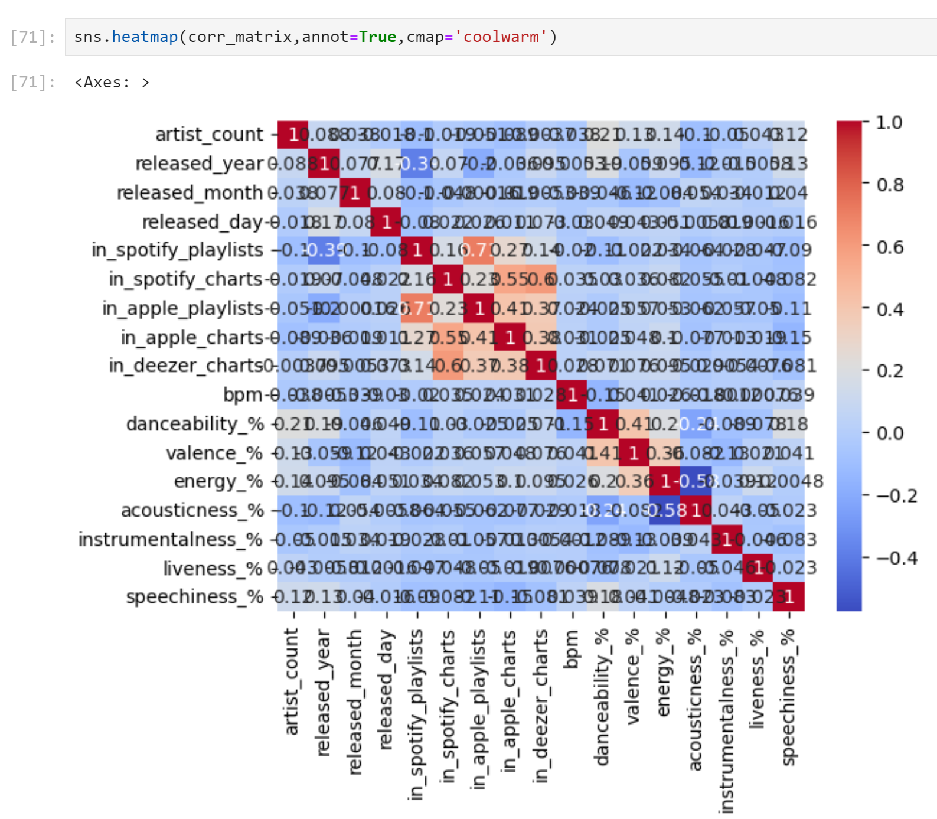
This caused some problems for the heat map associated with the correlation matrix

Slide 10
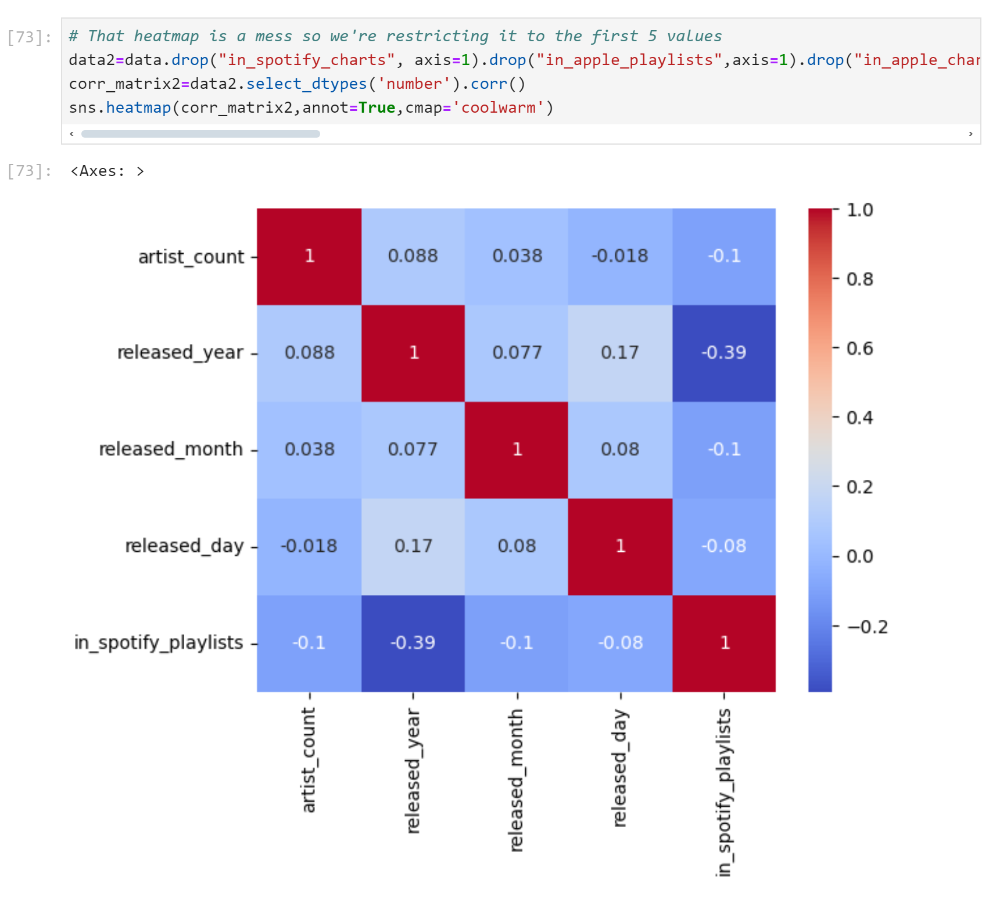
To get a better view of the correlation matrix, we drop the columns we don’t want to look at right now
By saving that into a new name, data2, we can make it into a corr matrix and see a cleaner heatmap

Slide 11
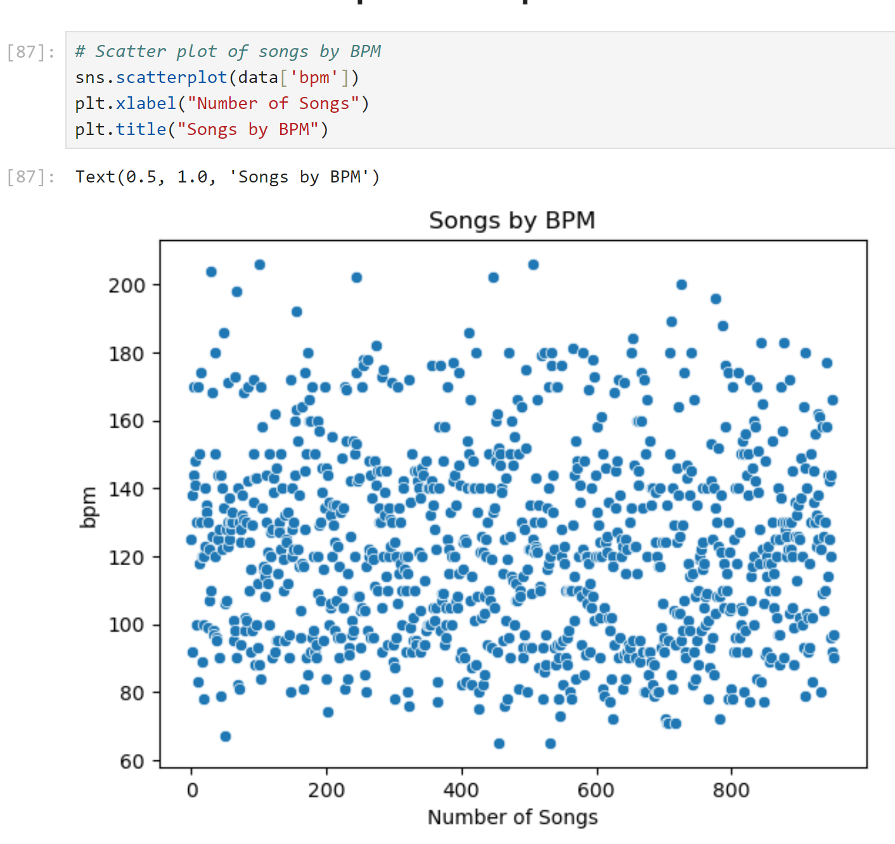

Slide 12
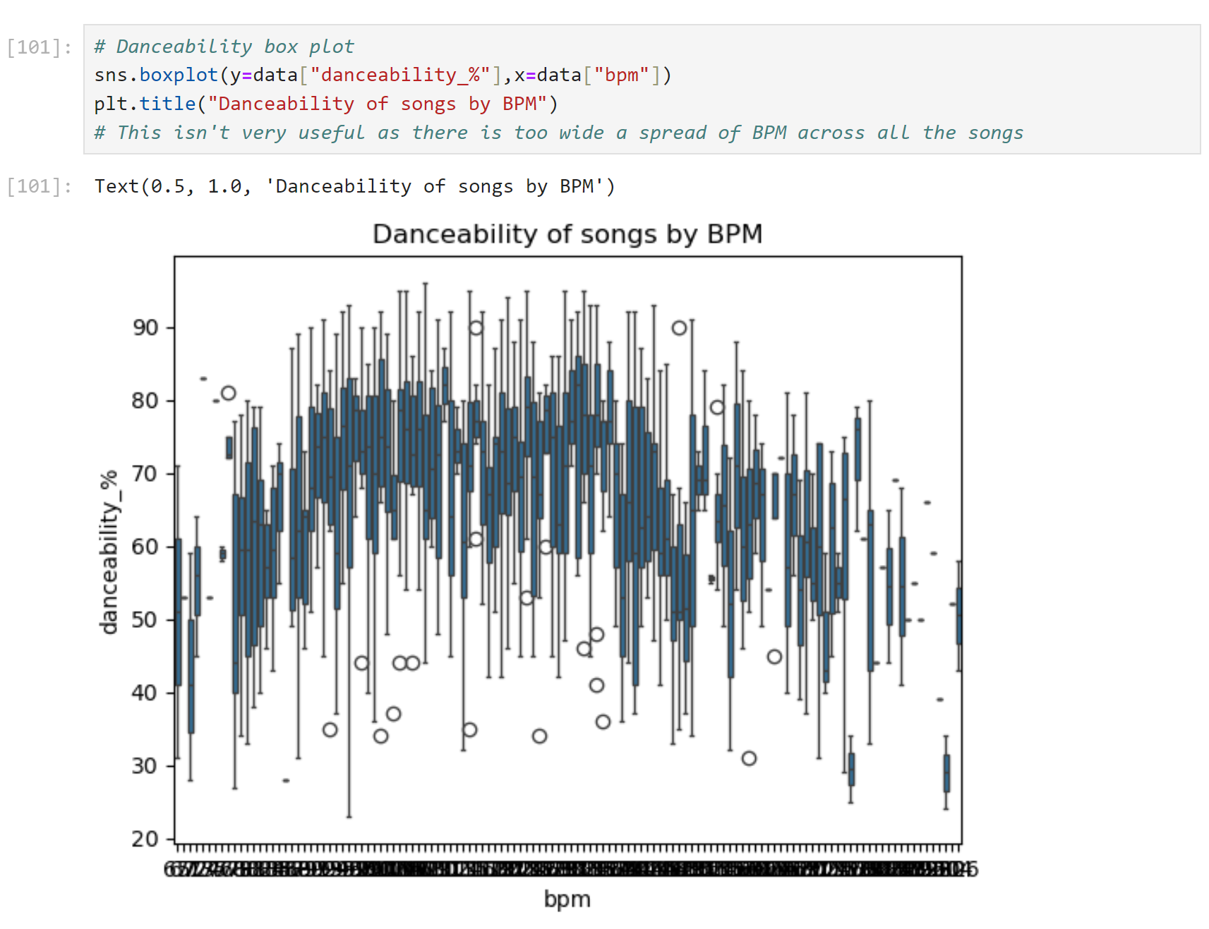

Slide 13
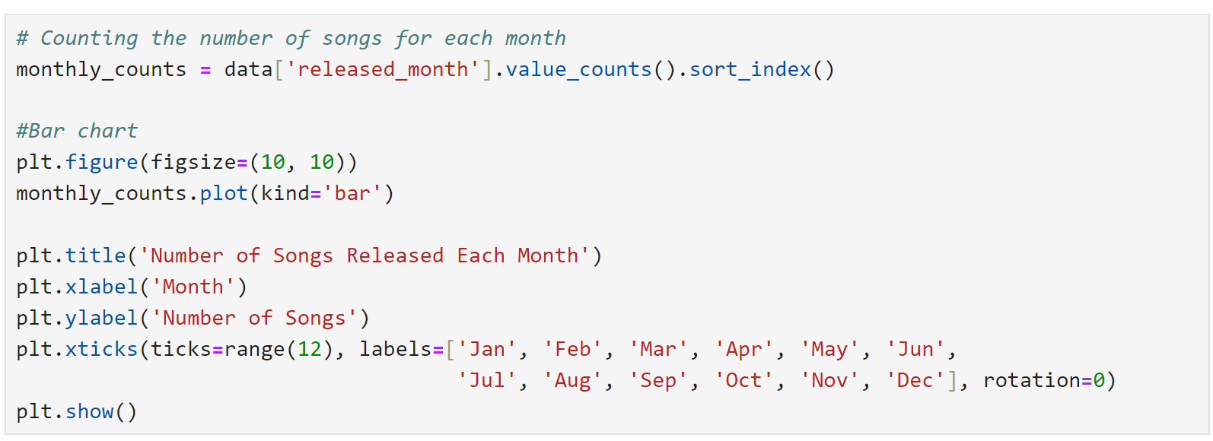
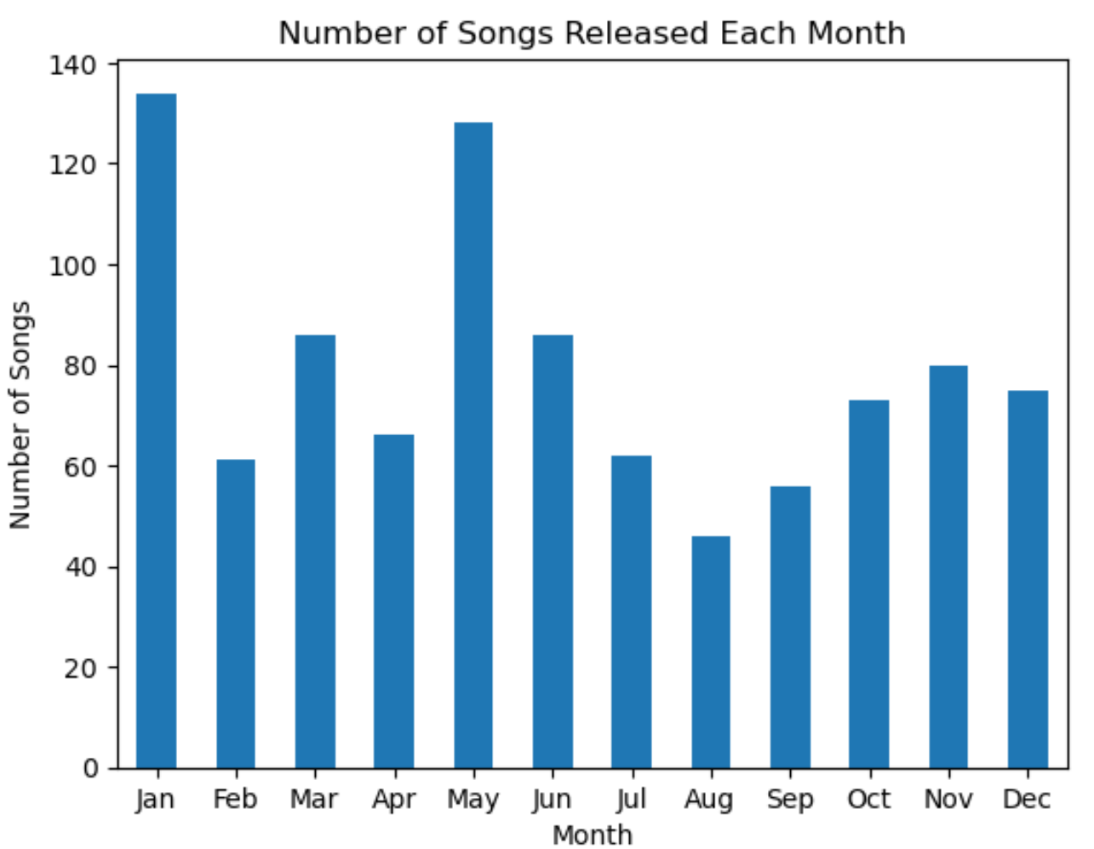

Slide 14
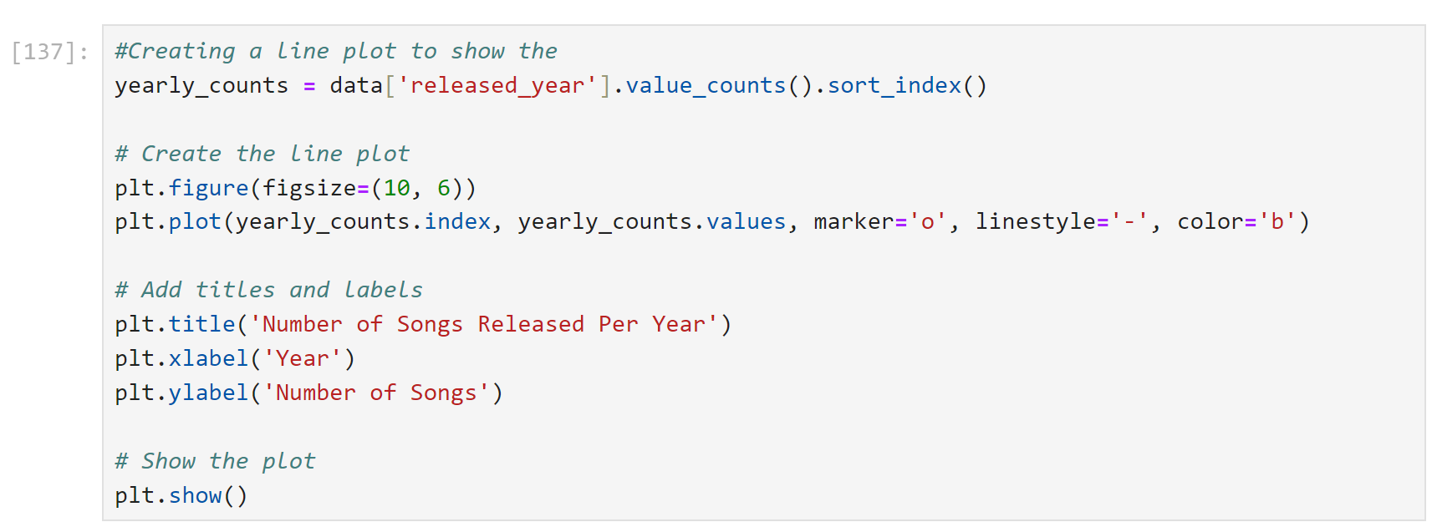
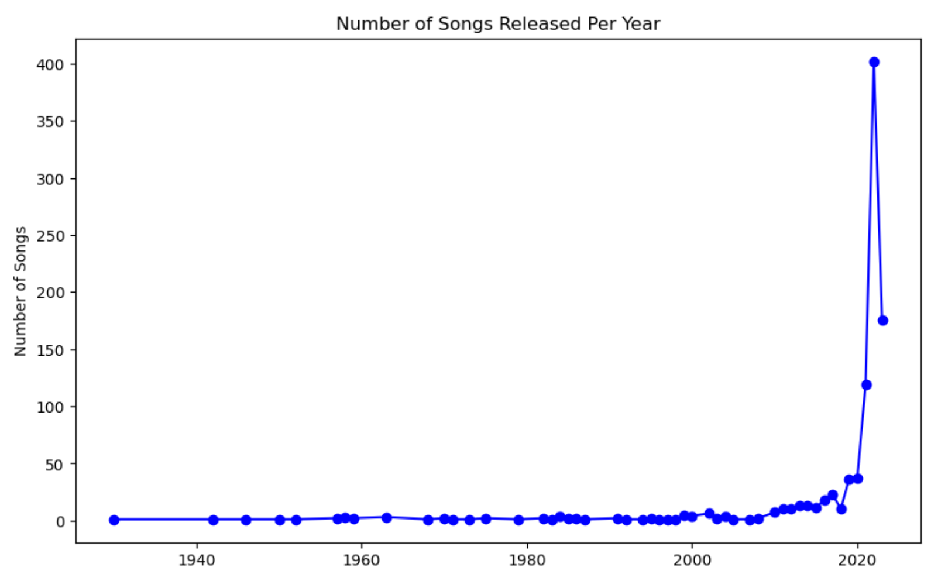

Slide 15
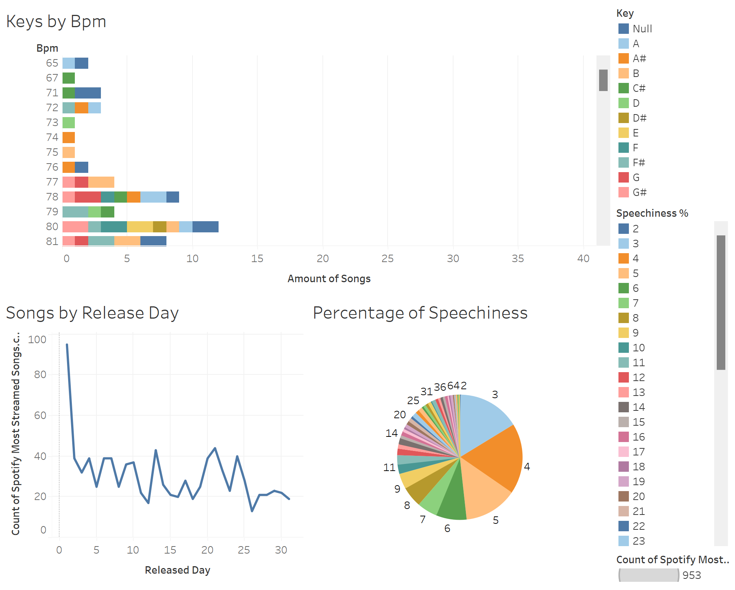

Slide 16

Summary
Majority of songs that were streamed were released in the start of the year (January) and early summer (May and June)
BPM has an even spread meaning there’s little correlation to a song’s popularity and BPM
In 2020 there was an increase in songs being released and a significant drop off during 2023
The more popular a song is, the more playlists it is added to on Spotify

